Slide 1
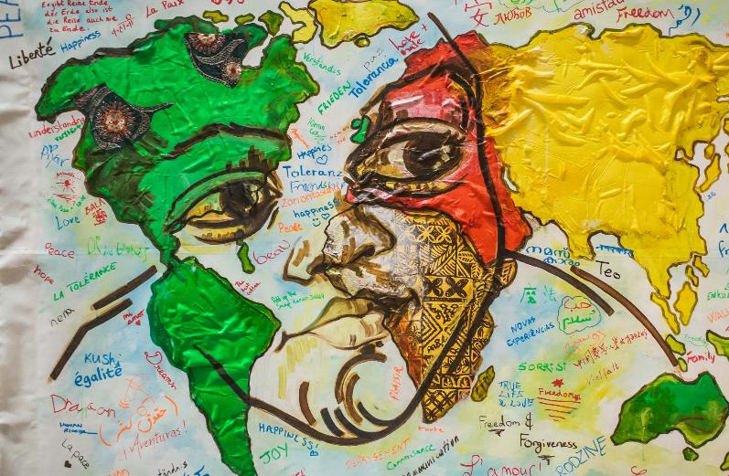
WRITING Workshop

Slide 2
Cinquains
Cinquains:
These create a sort of picture with words.
The set pattern is –
Noun
Adjective 1, adjective 2
Present participle, present participle, present participle (-ing)
Four word phrase
Closely related noun or synonym.

Slide 3
Example 1:
Sarah | Noun
Slow, tired, | Adjectives
Sinking, foundering, failing | Present participles
Needs some more sleep | Four-word phrase
Granny | Related noun

Slide 4
Example 2:
Happiness | Noun
Joyful, fun | Adjectives
Engaging, delighting, attracting | Present participles
Pulls us all in | Four-word phrase
Euphoria. | Related noun

Slide 5
HAIKU A Japanese form, allowing you to paint a picture with words. Has a very controlled structure. 3 lines, made up of 5 syllables; 7 syllables; 5 syllables
Five syllables here.
Seven more syllables here.
Are you happy now?
The moon lingers on
Lighting the frost-covered leaves
Making them sparkle.
The rainbow spans the blue sky
Sun shining, giving
Beautiful colours.

Slide 6
Haikus en español
Mario Benedetti (Uruguay, 1920-2009)
la mariposa
recordará por siempre
que fue gusano
no quiero verte
por el resto del año
o sea hasta el martes
Can be found at: http://adkaplan.blogspot.com/2009/06/haikus-de-mario-benedetti.html (Haikus 15 and 44)
Octavio Paz (Mexico, 1914-1998)
Hecho de aire
entre pinos y rocas
brota el poema.
Can be found at: https://www.tallerdeescritores.com/ejemplos-de-haiku

Slide 7
Haikus en français
Jean Paulhan (1884- 1968) | Tachibana Hokushi (1665 – 1718) OR Ozaki Hosai (1885 – 1926) | Bashô (1644 – 1694)
La rivière coule nue Les jeunes arbres vont vivre Dans les bois Can be found at: http://poetia.fr/haiku/la-riviere-coule-nue | Parfois, j’écris Parfois j’efface tout Ainsi, des fleurs de pavot Fleurs de pavot = poppies | Déjà quatre heures Je me suis levé neuf fois Pour admirer la lune. [the lines in this haiku don’t divide up so evenly – but just see it as a sequence of 17 syllables]

Slide 8
Translating haikus: Can you keep the form as well as the sense?
Un nouveau printemps Coule le flot de la vie Un nouvel espoir (Didier Hallépée) | Spring is waking up Life flow is running down New hope is coming
pasan misiles ahítos de barbarie globalizados (Mario Benedetti 1920-2009) | globalised missiles stuffed full of barbarism are passing us by

Slide 9
Acrostic poems
Teacher to insert Acrostic poems (x2) which are available at:
https://mrswattclassroom.weebly.com/acrostic-poem.html

Slide 10
Combining your languages creatively
Use puns or word play:
Dame más, Dame mash
son/ g
Use rhyme, rhythm, sound:
Moon lune/ chant song
cha cha charged with meaning
Translate idioms:
She doesn’t have hairs on her tongue (no tiene pelos en la lengua)
I’ve got the cockroach (j’ai le cafard)

Slide 11
Multilingual cinquain: Example
Monday
Désolée, déprimée
Despairing, despertando, desayunando
I’ve got the cafard
Cockroach

Slide 12
Multilingual haikus: examples
Pasan los días
Like a river, rivière
The days pass slowly
Escúchame, please
Tu m’écoutes? Je t’écoute
¿Me escuchas? Gracias.

Slide 13
Multilingual acrostic: example
 | D | antza | (Basque)
t | Á | nc | (Hungarian)
tan | N | ssi | (Finnish)
rin | C | e | (Irish)
With me pl | E | ase

Slide 14
Creative writing
Try writing a Cinquain, a Haiku or an Acrostic, using as many languages as you like.
OR
Write a poem like ‘My Language’ by Kumari Tarapatla, using a repeated phrase or a regular rhythm:
Teacher to insert poem here. Can be found in: Brave New Voices, A city imagined. https://www.englishpen.org/outreach/brave-new-voices-2-0-year-one/#read-bnv
OR
Invent your own form! It doesn’t have to be regular.

Slide 15
"The image and sound of Multilingualism" by The Language Project
https://www.youtube.com/watch?v=MM6Zlr_x-zM

Slide 16
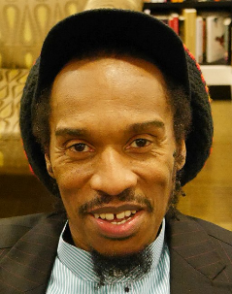
BENJAMIN zephaniah
Image (unchanged): Edwardx [CC BY-SA (https://creativecommons.org/licenses/by-sa/4.0)]

Slide 17
The british
Teacher to insert poem here.
Can be found at: https://benjaminzephaniah.com/rhymin/the-british-serves-60-million/

Slide 18
Edward Kamau Braithwaite
Image available for classroom use at:
https://www.theguardian.com/books/2020/feb/05/edward-kamau-brathwaite-obituary

Slide 19
The Awakening
Teacher to insert poem here.
Can be found in: The Arrivants: A New World Trilogy. Edward K Braithwaite
Published by OUP Oxford, 1981
ISBN: 9780199111039

Slide 20
Daljit Nagra
Image (unchanged): Simon James [CC BY-SA (https://creativecommons.org/licenses/by-sa/2.0)]

Slide 21
Rapinder Slips into Tongue
Teacher to insert poem. Can be found at:
https://www.poetryinternational.org/pi/poem/19356/auto/0/0/Daljit-Nagra/RAPINDER-SLIPS-INTO-TONGUE/en/nocache
Video Version: (Intro – until 00:38)
https://www.youtube.com/watch?v=EBGYSchCfII

