Slide 1
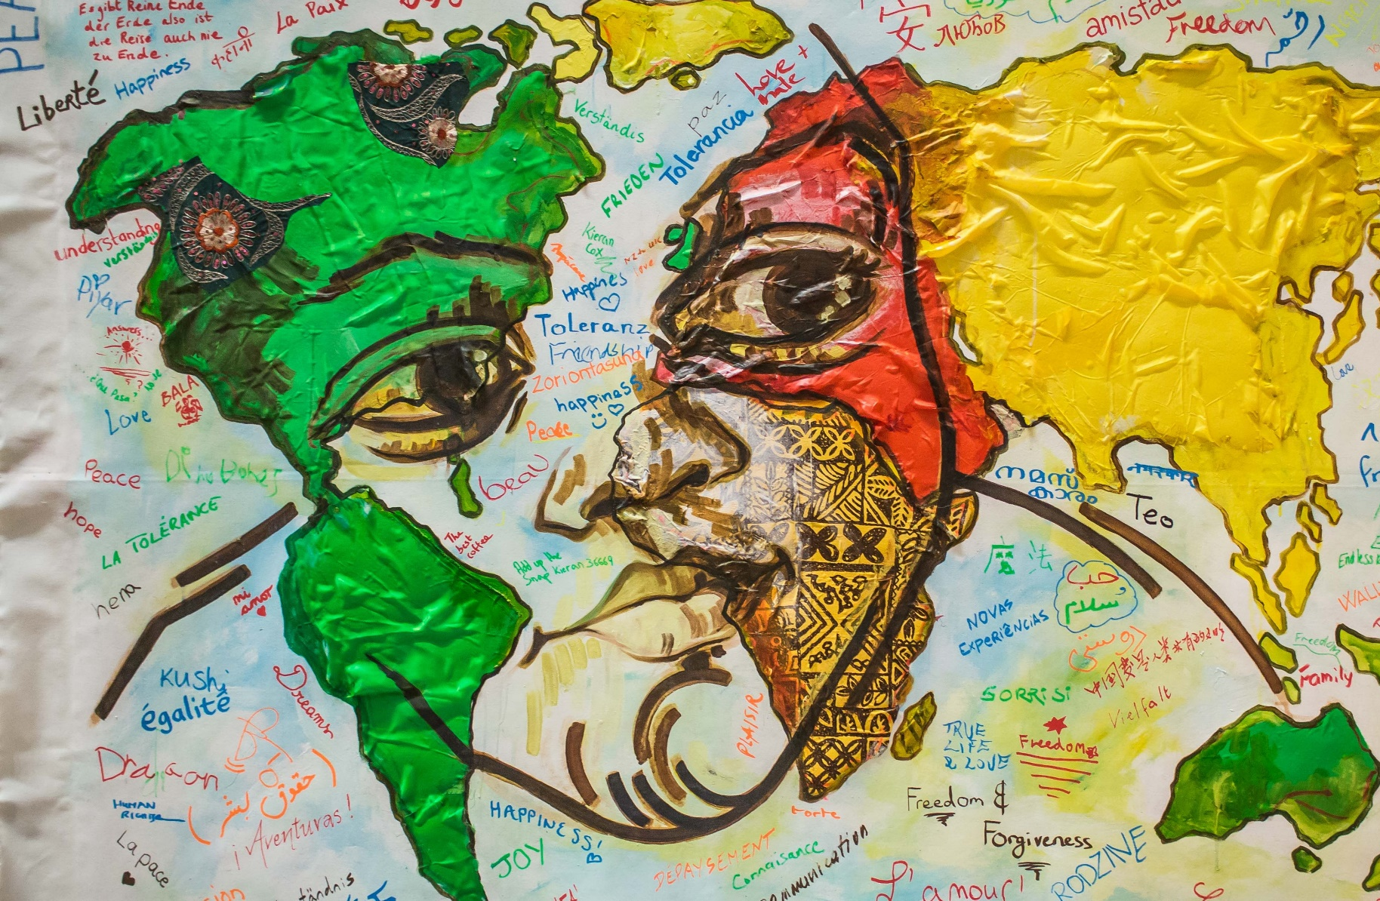
Multilingualism in the Classroom

Slide 2
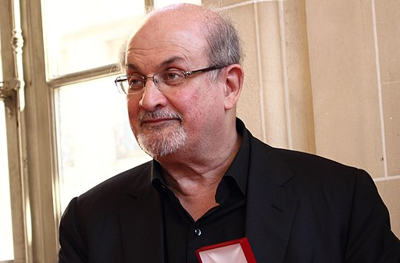
‘Mélange, hotchpotch, a bit of this and a bit of that is how newness enters the world. It is the great possibility that mass migration gives the world, and I have tried to embrace it.’
Salman Rushdie, Imaginary Homelands (1991)
Image (unchanged): ActuaLitté [CC BY-SA (https://creativecommons.org/licenses/by-sa/2.0)]

Slide 3
‘My Language’, by Kumari Tarapatla
Teacher to insert poem here.
Can be found in: Brave New Voices, A city imagined.
https://www.englishpen.org/outreach/brave-new-voices-2-0-year-one/#read-bnv
Short video of Brave New Voices: A city imagined – the launch! featuring performances by selected poets can be found here:
https://www.youtube.com/watch?v=bwUDg7CN_-o

Slide 4
‘My Language’, by Ola Ololade
Teacher to insert poem here.
Can be found in: Brave New Voices, A city imagined.
https://www.englishpen.org/outreach/brave-new-voices-2-0-year-one/#read-bnv

Slide 5
‘I Speak (Eu Falo)’, by Samira Beatriz Fidelis translated by Constance Forrest
Teacher to insert poem here.
Can be found in: Brave New Voices, A city imagined.
https://www.englishpen.org/outreach/brave-new-voices-2-0-year-one/#read-bnv

Slide 6
BENJAMIN zephaniah
Image (unchanged): Edwardx [CC BY-SA (https://creativecommons.org/licenses/by-sa/4.0)]

Slide 7
The british
Teacher to insert poem here.
Can be found at: https://benjaminzephaniah.com/rhymin/the-british-serves-60-million/

Slide 8
Edward Kamau Braithwaite
Image available for classroom use at:
https://www.theguardian.com/books/2020/feb/05/edward-kamau-brathwaite-obituary

Slide 9
The Awakening
Teacher to insert poem here.
Can be found in: The Arrivants: A New World Trilogy. Edward K Braithwaite
Published by OUP Oxford, 1981
ISBN: 9780199111039

Slide 10
Daljit Nagra
Image (unchanged): Simon James [CC BY-SA (https://creativecommons.org/licenses/by-sa/2.0)]

Slide 11
Rapinder Slips into Tongue
Teacher to insert poem. Can be found at:
https://www.poetryinternational.org/pi/poem/19356/auto/0/0/Daljit-Nagra/RAPINDER-SLIPS-INTO-TONGUE/en/nocache
Video Version: (Intro – until 00:38)
https://www.youtube.com/watch?v=EBGYSchCfII

